Slide 1

Human Rubbish verses
Divine Righteousness
3:1 – 11
Week 37
30 November 2022

Slide 2

Philippians overview chapter three
In this third chapter, we are given a warning against those who place great confidence in the flesh (1-3). If anyone had reason to boast about fleshly accomplishments, it was Paul with his Jewish heritage (4-6). But for Paul, all such things were considered rubbish in relation to the excellence of knowing Christ Jesus (7-8).
Therefore Paul had as his goal to be found in Christ, having that righteousness which is by faith in Jesus; and knowing Jesus through the power of His resurrection; and even sharing in Jesus’s sufferings, so that Paul might by any means attain to the resurrection from the dead (9-11).

Slide 3
Philippians overview chapter three
Paul then describes his attitude of pressing on, and encourages all to follow his example and that of others who walk likewise (12-17).
Such an exhortation is necessary in view of the reality that there are many people who are enemies of the cross of Christ, who have made their fleshly appetites the focus of their minds, and indeed their god (18-19).
The chapter closes by reminding Christians that our true citizenship is in heaven, from which we eagerly wait for Jesus Christ who will transform our lowly bodies to be conformed to His glorious body (20-21).

Slide 4


Slide 5

Human Rubbish verses Divine Righteousness

Slide 6
Philippians 3:1 – 11
Our world honors and rewards high achievement. Trophies, medals, plaques, and awards are given to those who stand out among the crowd. Though there’s nothing inherently wrong with appreciating and applauding great accomplishments, these accolades can be very deceptive, leading many to believe that their earthly successes and temporal earnings can somehow translate into heavenly merits or eternal rewards.
Among the many worldly messages we’re tempted to believe, the one that emphasizes self-promotion—that is, finding confidence in our own pedigrees and achievements—can be the most alluring. In such a world, how desperately we need God’s truth!

Slide 7
Philippians 3:1 – 11
If for no other reason than to counteract society’s lies, we need His principles and precepts to guide us aright. Again and again in the Bible we discover a perspective that stands in stark contrast with the rubbish on the street. In our fight-back, get-even world, it’s so easy to embrace the philosophy espoused there and to adopt its methods.
If anyone ever had the opportunity to boast of their accomplishments, Saul of Tarsus was that person. In fact, that’s exactly what he did throughout his adult life—until he met and bowed before Jesus as Lord. That encounter changed everything. From then on he considered all things outside of Christ and His righteousness as mere “rubbish” or “dung” (1:8).

Slide 8
Philippians 3:1 – 3
¹Finally, my brethren, rejoice in the Lord. For me to write the same things to you is not tedious, but for you it is safe. ²Beware of dogs, beware of evil workers, beware of the mutilation! ³For we are the circumcision, who worship God in the Spirit, rejoice in Christ Jesus, and have no confidence in the flesh,

Slide 9
Philippians 3:1 – 3
Paul opens the third chapter with a unique phrase that appears for the first time here and only again in Philippians 4:4 and 4:10 in the entire NT: “Rejoice in the Lord.” Yet this refrain sums up what Paul has been accentuating repeatedly with his emphasis on joy and rejoicing. If we recognize Philippians 3:1 as a kind of hinge that transitions Paul from one subject within a broader theme to another, we can better understand the significance of the unique phrase “rejoice in the Lord.”
In 3:1, Paul uses an introductory phrase that suggests he is shifting lanes—still driving in the same direction, but covering a different line of discussion. Instead of “finally,” a better translation would be “in any case” or “furthermore.”

Slide 10
Philippians 3:1 – 3
The imperative “rejoice in the Lord,” then, serves not simply to sum up his previous discussion, but to advance it in order to “safeguard” his readers from some imminent harm to their authentic joy. In particular, Paul knew there were legalistic joy stealers, often referred to as Judaizers, on the prowl, hounding the Gentiles believers to live by their strict, man-made religious codes.
Instead of rejoicing in the Lord and the grace of salvation that comes only through His person and work, they were rejoicing in their own accomplishments in fulfilling the Law. This threat was so serious that Paul denounced it with three disparaging description (3:2).

Slide 11
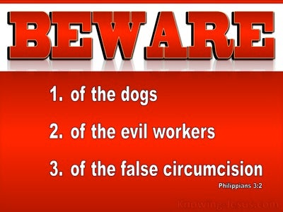

Slide 12
Philippians 3:1 – 3
FIRST – in comparing the legalists to “dogs,” Paul didn’t have in mind polite, pampered, and potty-trained house pets. Instead, picture feral dogs roaming the backstreets in packs—dirty, flea-infested, disease-ridden scavengers with uncertain pedigrees . . . mangy mutts!
They were uncontrolled and dangerous to anybody who got too close. So Paul warns the Philippians to stay away! Some self-righteous Jews of the time also used the term “dogs” to refer to unclean Gentiles. Thus it’s ironic that Paul turns the insult on these Jewish Christians who were trying to prop up their man-made ways of purity.

Slide 13
Philippians 3:1 – 3
SECOND – he calls them “evil workers.” Ironically, the Judaizers were claiming to be the promoters of good works—works so good, in fact, that they could merit a right standing before God. However, Paul says they were actually workers of evil. They sowed a corrupt, twisted non-gospel, teaching that people could be saved only by faith plus works of the Law.
However, the good news of Jesus Christ is that salvation is by grace alone (it’s a gift!), through faith alone (not by works!), in Christ alone (not by any means other than the person and work of Christ!). We are to rejoice in the Lord and what He has done for us, not in any human means of trying to gain favor with God.

Slide 14
Philippians 3:1 – 3
THIRD – the false teachers are “the false circumcision.” This translation softens the harsh language evident in Paul’s original Greek. He uses a Greek term that sounds similar to the word for “circumcision,” but he modifies it slightly to render the word as “cutting off,” “mutilation,” or perhaps “castration.” This is how Paul describes those who say that men must be circumcised to be saved.
Having fired back at the robbers of Christ-centered joy, Paul concludes his warning by reminding the Philippians that genuine Christians are “the true circumcision” (3:3). He mentions three fundamental differences between the authentic bearers of God’s redemption and the pretenders.

Slide 15
Philippians 3:1 – 3
FIRST – true believers “worship in the Spirit of God,” meaning their focus is on the work of the divine Spirit in salvation, not on fleshly means of personal merit.
SECOND – unlike those who bragged about their achievements before God by keeping the Law, Christians “glory in Christ Jesus.”
THIRD – authentic Christ followers “put no confidence in the flesh.” They rejoice in the Lord—not in human works, not in personal piety, not in anything but the person and work of Christ.

Slide 16


Slide 17
Philippians 3:4 – 6
⁴Though I also might have confidence in the flesh. If anyone else thinks he may have confidence in the flesh, I more so: ⁵circumcised the eighth day, of the stock of Israel, of the tribe of Benjamin, a Hebrew of the Hebrews; concerning the law, a Pharisee; ⁶concerning zeal, persecuting the church; concerning the righteousness which is in the law, blameless.

Slide 18
Philippians 3:4 – 6
In order to expose the absurdity of those who place confidence in their own achievements, wrought in their own power for the purpose of meriting approval with God, Paul uses himself as an example.
Remember, the rabid dogs in Paul’s crosshairs were trying to boast about keeping the Law. Now, with one twang of the bow after another, Paul pierces the Judaizers’ position by demonstrating that if anybody could boast about their fleshly achievements, it was he himself (3:4).

Slide 19
Philippians 3:4 – 6
If anybody could have merited favor with God, it would have been this ex-Pharisee whose religious trophies could have lined the walls of a Hall of Fame:
circumcised on the eighth day as a son of the covenant.
born into the nation of Israel, not a converted Gentile.
a member of the tribe of Benjamin, an honorable people.
a true Hebrew among Hebrews, the best of the best.
a Pharisee with respect to observance of the Law.
a zealous persecutor of the church in the name of the Law.
blameless with regard to external righteousness found in the Law.

Slide 20
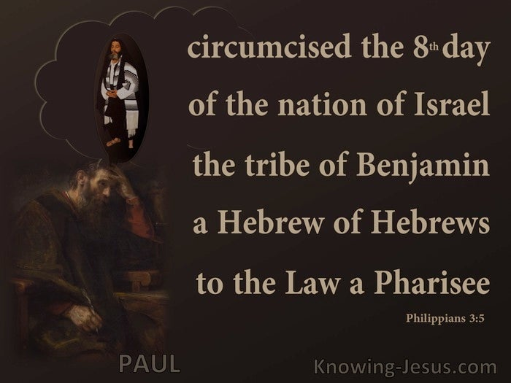

Slide 21
Philippians 3:4 – 6
If you were a first-century Jew, you’d be impressed by this list! Paul was the Jew par excellence. He set a high bar for his fellow Jews and an impossible standard for any Gentiles who would hope to fulfill the Law themselves.
If the Law were the authentic standard of right standing with God, Paul would have been the paragon of righteousness.

Slide 22
Philippians 3:7 – 8
⁷But what things were gain to me, these I have counted loss for Christ. ⁸Yet indeed I also count all things loss for the excellence of the knowledge of Christ Jesus my Lord, for whom I have suffered the loss of all things, and count them as rubbish, that I may gain Christ.

Slide 23
Philippians 3:7 – 8
If you had been able to listen to the Jerusalem rabbis of the day, perhaps you would have heard them name-dropping Saul of Tarsus—that brilliant, passionate rabbinical student who studied under the famous teacher Gamaliel in Jerusalem. When his teachers wanted to scold the less rigorous young men, they may have pointed at Saul and said, “Why can’t you be more like him?” And when Saul secured a special commission from the high priest in Jerusalem to help put an end to the followers of Jesus as Christ (Acts 9:1-2), his rising star in Judaism seemed bright.
Until Damascus. At that point everything changed. A blazing light from heaven blinded him in an instant, and he heard a voice calling out to him, “Saul, Saul, why are you persecuting Me?” (Acts 9:4).

Slide 24
Philippians 3:7 – 8
Traumatized by the sudden encounter with what was clearly a heavenly being—but still completely clueless that he was following the wrong path of devotion—Saul asked, “Who are you Lord?” (Acts 9:5).
Saul must have stopped breathing and his heart must have sunk when he heard the reply: “I am Jesus whom you are persecuting” (Acts 9:5).
At that moment, the entire checklist of achievements became a pointless scribbling on paper. The trophies of spiritual accomplishments in the display case of his pride turned to dust and blew away. The years and years of torturous labor to distinguish himself “as to the Law . . . as to zeal . . . as to the righteousness which is in the Law” (3:5-6)—an utter waste of time, energy, and talent.

Slide 25
Philippians 3:7 – 8
The words of Isaiah 64:6 became a personal reality for Saul: “All [my] righteous deeds are like a filthy garment.”
Having highlighted his accomplishments in Philippians 3:4-6, Paul starts the next statement with a pronounced BUT! In the Greek, this word “But” implies a much more pronounced contrast: “But on the contrary …” (3:7).
The point is clear: Paul is utterly rejecting his former confidence in self-righteousness that was based on his pedigree and prominence in Judaism in favor of “the surpassing value of knowing Christ Jesus as Lord (3:8). In making this radical contrast, Paul employs some pretty strong language to drive home his point.

Slide 26
Philippians 3:7 – 8
In fact, the language he uses increases in rhetorical power, and the Philippians got the message loud and clear by the time Paul’s emphasis shifted to the righteousness that comes through Christ (3:9).
First, Paul begins the pummeling of his past with a vivid image: “Whatever things were gain to me, those things I have counted as loss for the sake of Christ” (3:7). He once regarded his previous religious achievements to be profitable, advantageous, and commendable. But now? These things are re-categorized in Paul’s mind as “loss.” The same Greek word for cargo and lives lost in a shipwreck (Acts 27:10).

Slide 27
Philippians 3:7 – 8
Throughout his life, Saul of Tarsus had stored up a cargo of what he thought were priceless goods, but that whole collection had been torpedoed by God’s saving grace on the road to Damascus. Instead of mourning the loss, Paul regarded it as a necessary casualty “for the sake of Christ.”
Next, to avoid any sense that he was regretting the loss of those things he had so highly valued in his former life in Judaism, Paul insists, “More than that, I count all things to be loss in view of the surpassing value of knowing Christ Jesus my Lord” (3:8).
Everything that had shined so brightly in his life—not just the glory of his former emphases in Judaism—had faded to darkness when placed in the exceeding light of the knowledge of Christ’s salvation.

Slide 28
Philippians 3:7 – 8
Finally, Paul pulls out all the rhetorical stops as he reaches a shocking climax: “For [Christ] I have suffered the loss of all things, and count them but rubbish so that I may gain Christ” (3:8). The term politely translated “rubbish” would have likely raised eyebrows or caused a few gasps when the Philippians first read or heard it.
The Greek word Paul chose to compare all earthly treasures and accomplishments to Christ literally means “dung, excrement, manure.” On this word one commentator notes, “Some scholars are prone to translate this as ‘garbage.’ It is used for ‘dung,’ however, and the strongest possible contrast makes best sense of this passage.”

Slide 29
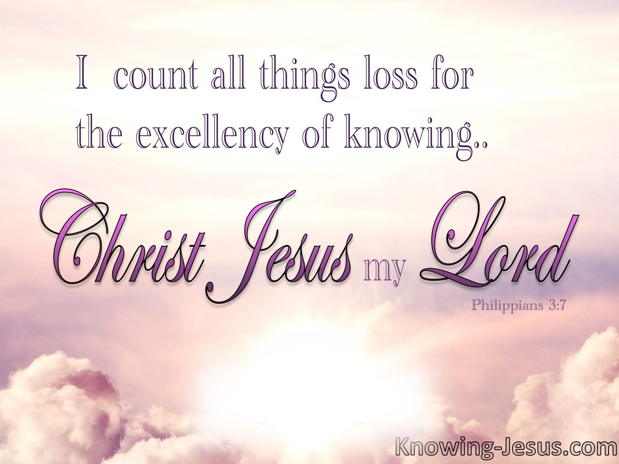

Slide 30
Philippians 3:9 – 11
⁹And be found in Him, not having my own righteousness, which is from the law, but that which is through faith in Christ, the righteousness which is from God by faith; ¹⁰that I may know Him and the power of His resurrection, and the fellowship of His sufferings, being conformed to His death, ¹¹if, by any means, I may attain to the resurrection from the dead.

Slide 31
Philippians 3:9 – 11
With his ego-laden ship sunk, Paul wasn’t mourning his loss but shouting out a jubilant “Good riddance!” What his spiritually blinded eyes had seen as a boatload of treasures, the light of Christ had revealed as a pile of manure!
Instead of mourning the loss of those useless things he had hoarded by his own strength, Paul rejoiced in the Lord (3:1) for receiving things he could never have earned on his own:
being found in the Lord Jesus Christ (3:9).
receiving righteousness from God, not from himself (3:9).
being justified by faith, not by works of the Law (3:9).

Slide 32
Philippians 3:9 – 11
knowing Christ (3:10).
experiencing the power of Christ’s resurrection (3:10).
sharing in Christ’s suffering and death (3:10).
Embracing the hope of resurrection from the dead (3:11).
In 3:9 we find a great summary of the doctrine know as imputation, a term that refers to crediting something to a person’s account. Here’s a simple definition of how the word is used theologically: “In salvation, our sin and guilt are credited to Christ, and His righteousness is credited to us.” Because Paul was now “in Christ,” everything that Christ had accomplished through His death and resurrection—payment for sin and eternal life—had been credited to Paul’s otherwise bankrupt account.

Slide 33
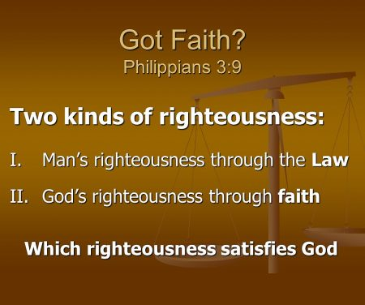

Slide 34
Philippians 3:9 – 11
Paul had thought that the massive sum in his “righteousness” account had made him rich. What he hadn’t realized was that the balance was a negative number!
The righteousness that was credited to Paul’s account the moment he embraced Christ by faith was the unmeasurable righteousness of the perfect God-man.
And Christ’s righteousness not only canceled Paul’s debt, but it also placed in his account “everything pertaining to life and godliness” (cf., 2 Peter 1:3).

Slide 35
Philippians 3:9 – 11
The result of this new relationship was that the power of Christ’s resurrection became a present reality for Paul, allowing him to rejoice even as he shared in Christ’s suffering (3:10).
Paul could now see that the suffering he was enduring for his faith was a means of conforming him to Christ’s character of selfless humility.
And this new relationship sealed the promise of future hope—attaining to the resurrection from the dead (3:11).

Slide 36
Applications
Of the
lesson

Slide 37
Philippians Application
A couple of very simple reminders grow out of the contrast Paul shares in Philippians 3:1-11 . . .
FIRST – trusting in your own achievements can bring you glory now, but it leaves you spiritually bankrupt later.
The hardest part of getting driven, self-made, “type A” people to understand the gospel is to help them understand that grace is unmerited favor. It can’t be earned. It can’t be bought. It can’t be sought and found. It can only be received. This hard truth is painful for go-getters who have come to believe that anything worth having is worth sweating for. The truth is, when it comes to salvation, surrendering our efforts is the only way to gain a restored relationship with God, the result of which is eternal life.

Slide 38
Philippians Application
SECOND – trusting in Christ’s accomplishment on the cross gives Him the glory now and results in our eternal righteousness.
This is what Paul means when he tells the Philippians to “rejoice in the Lord” (3:1). We glory in Him, not in ourselves. We celebrate His accomplishments for us, not our work for Him. We praise and thank Him for who He is and what He has done, forgetting ourselves and our achievements and ignoring our own resumes. We give Him glory now.
Paul discovered—and perhaps you will too—that all human efforts to live a life pleasing to God apart from Christ are pointless and fruitless.

Slide 39



Slide 40
NEXT CLASS – 7 December 2022
Book of Philippians
Before next class, read the below verses in the NKJV and in one other versions of the Bible, i.e., NIV, NRSV, KJV, CEV, etc …
Chapter 3:12 – 21
“Hanging Tough and Looking Up”

Slide 41

the end
Questions
Questions

Slide 45
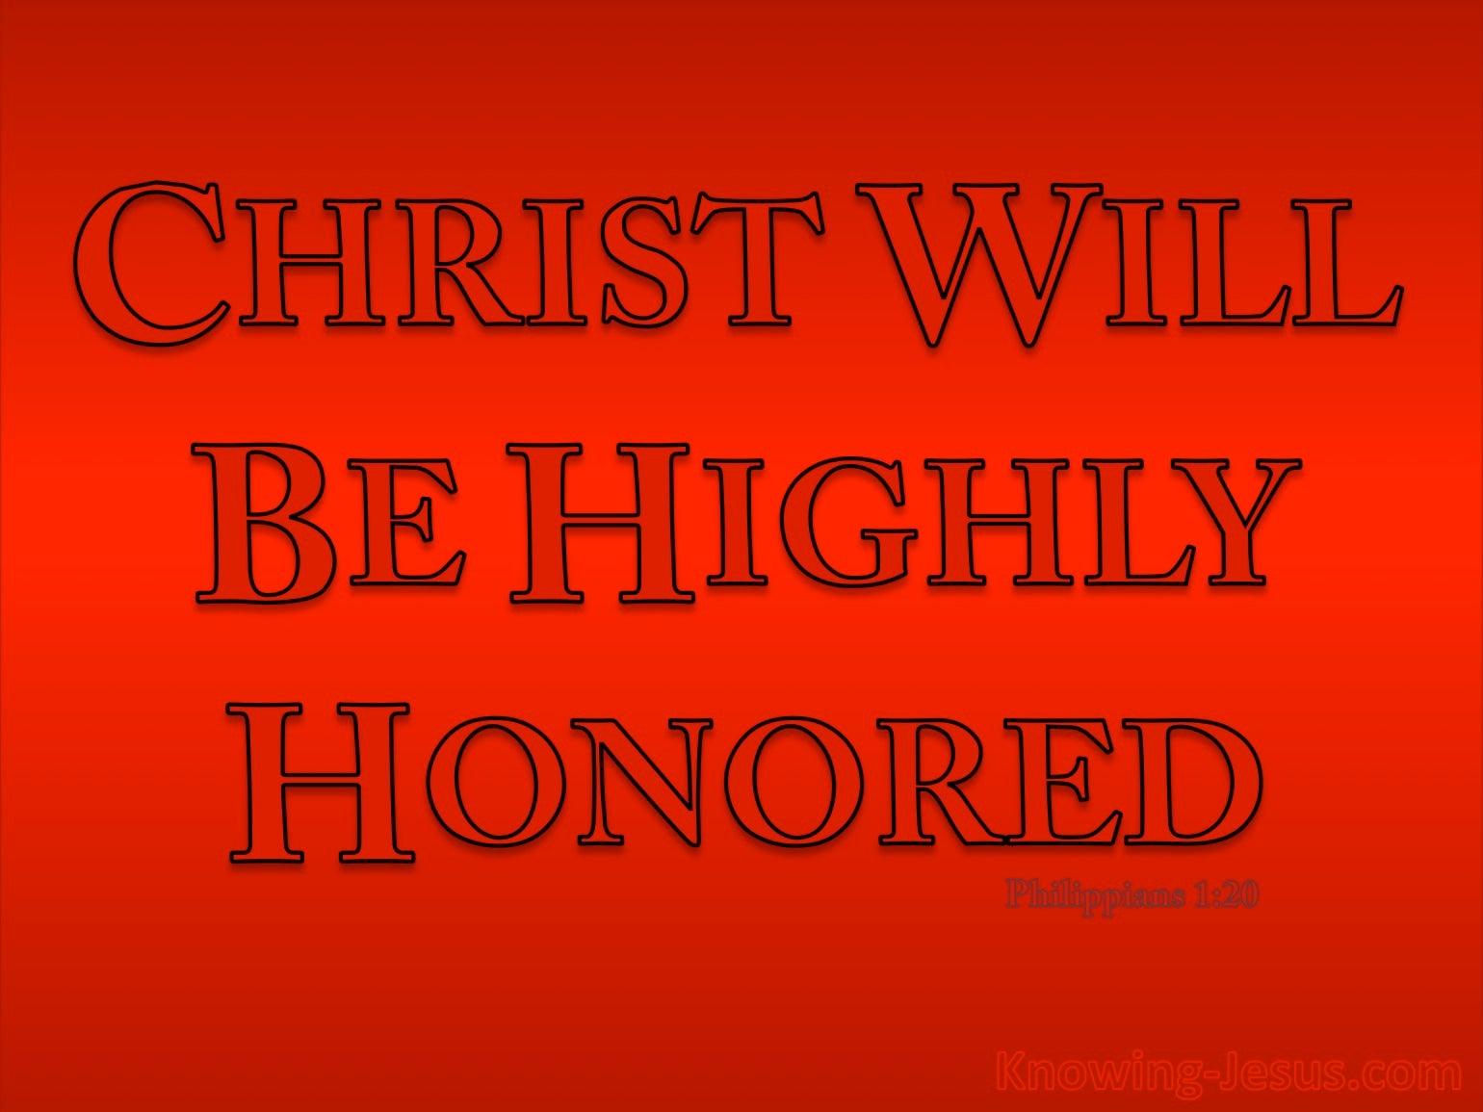

Slide 46
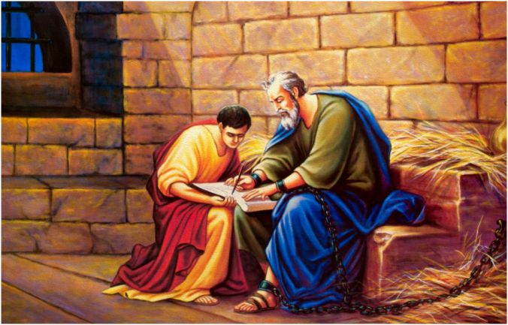
Paul and Timothy

Slide 47


Slide 48
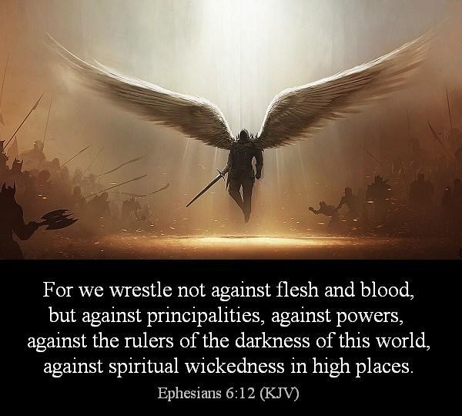

Slide 49
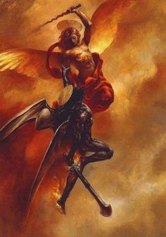
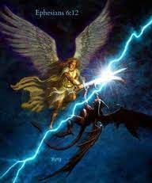

Slide 50
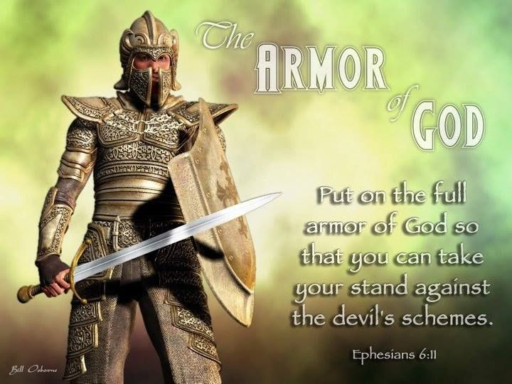

Slide 51
Ephesians
Application of Chapter 4:1 – 6
  We are aware that each of us is unique. We have different temperaments, gifts, experiences, convictions, interests, blessings, and different pains and scars. Yes, one of the things we all have in common is that each of us is completely different.
  But surely people with so many different backgrounds can’t live together in peace, can they? Can Paul’s seven theoretical facets of oneness be translated into lasting unity?

Slide 52
Ephesians
Application of Chapter 4:1 – 6
  In order to maintain purity of doctrine and practice, we need to break away from believers who aren’t living up to our standards, don’t we?
  Surely God cheers us on when churches split over incidentals or when Christians shun one another over a difference of opinion, right?
  Wrong! We need to repent of these ways of thinking and to stop these ways of acting. None of these things reflect a walk worthy of our calling. None of them flow from a life of humility, gentleness, patience, tolerance, and love.

Slide 53
Ephesians
Application of Chapter 4:1 – 6
  Let’s look at where they could come from . . .
  Ask yourself, am I a gossip? Do I spread rumors? Do I sow discord within the family of God?
  Do I ignore the major truths that unite me with other believers? Do I quickly lose patience with others? Do I hold grudges? Harbor bitterness?
  If you find yourself guilty of any of these charges, ask yourself, “Why do I do these things?”

Slide 54
Ephesians
Application of Chapter 4:1 – 6
  Where did you learn this? You didn’t learn it from Christ. You weren’t moved toward disunity and discord by the work of the Spirit. You didn’t become a part of the church’s problem by pursuing obedience to God the Father.
  Where did this come from? It came from one or more of three sources: the world, the flesh, and the devil. When you find yourself guilty of these things, throw yourself upon God’s mercy and claim His forgiveness. Then, commit to “the unity of the Spirit in the bond of peace” (4:3).

Slide 55
Romans
Application of Chapter 1:1 – 17
[1] – You Accept the Gospel.
  You don’t rewrite it, reshape it, or revise it. You accept it as an invitation. You’re invited to a new life of faith in Christ – forgiven of all your sins, cleansed by the work of Christ on your behalf, and set free to live a new life by the power of the Spirit.
  Paul will expand on all of these effects throughout his letter to the Romans. But in order for the good news of Jesus Christ to be great news for us, we need to first accept the invitation.

Slide 56
Romans
Application of Chapter 1:1 – 17
[2] – You Live the Gospel.
  Living the gospel means being set apart for the gospel for “obedience of faith” (1:5). Anyone who genuinely comprehends the magnitude of God’s gift won’t be able to remain idle.
  Their priorities, passions, and pursuits will necessarily change. They’ll begin to praise and thank God for what He’s done. They’ll worship and obey the one who saved them. They’ll set their hope on things above, love God, and live a life of service rather than selfishness.

Slide 57
Romans
Application of Chapter 1:1 – 17
[3] – You Share the Gospel.
  Paul considered himself indebted to all of humanity because he had been entrusted with a priceless gift, the only cure for the deadly disease of sin(1:14-15). Like Paul, whose who have accepted the free gift of eternal life have an obligation to share it.
  Share the fact that God has extended the offer of salvation to everyone, whether privileged or poor. Sharing the gospel will mean facing the same kinds of rejections Paul faced, but we must remain steadfast, even if it means sacrificing our lives.

Slide 58
Ephesians 4:4 – 6
⁴There is one body and one Spirit, just as you were called to one hope when you were called; ⁵one Lord, one faith, one baptism; ⁶one God and Father of all, who is over all and through all and in all.

Slide 59
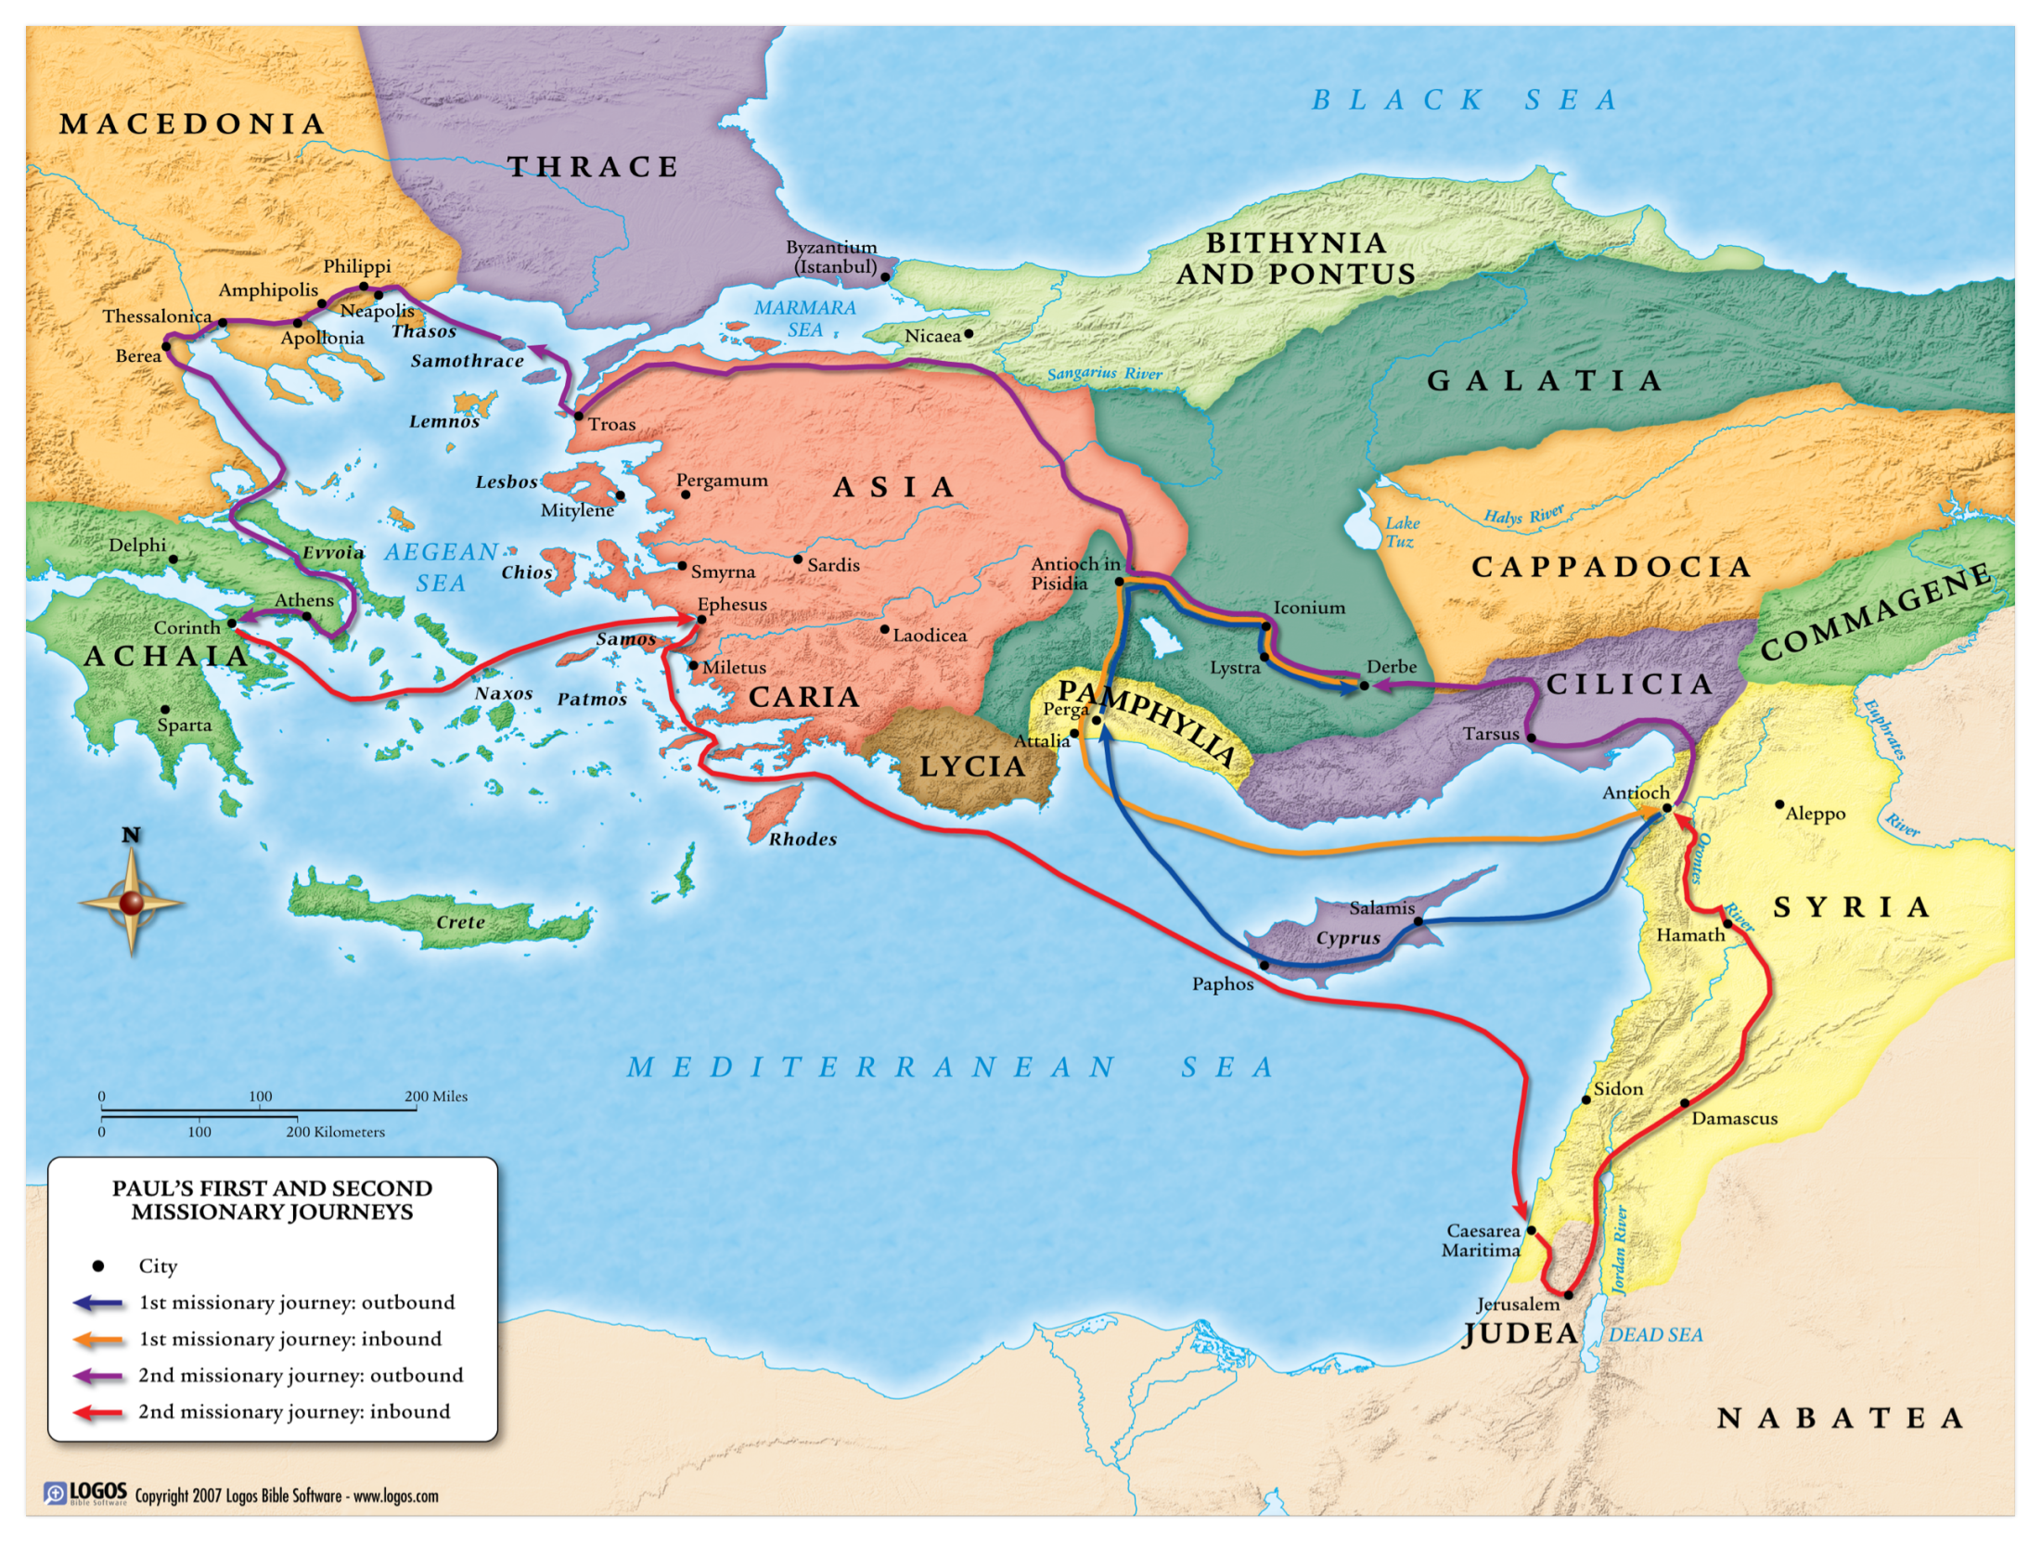

Slide 60
An overview
of the
Book of Galatians
https://youtu.be/vmx4UjRFp0M

Slide 61
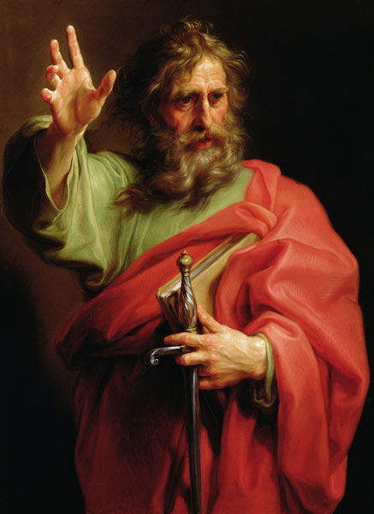
Hebrews
Apostle Paul

Slide 62
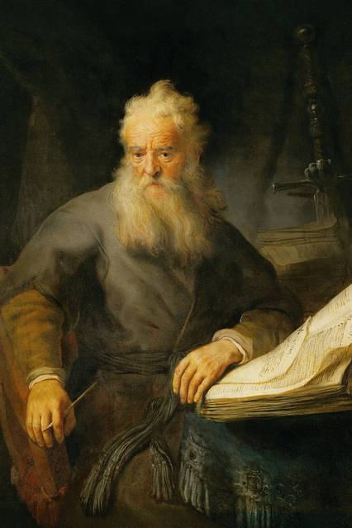
Hebrews
Why: To emphasize the superiority of Christ over the Old Covenant.
Synopsis: Jesus is better than any Old Testament person or sacrifice.
Comparison: The book of Hebrews is the “Gospel for the Jews” just as the Book of Romans is the “Gospel for the Gentiles.”
Apostle Paul

Slide 63
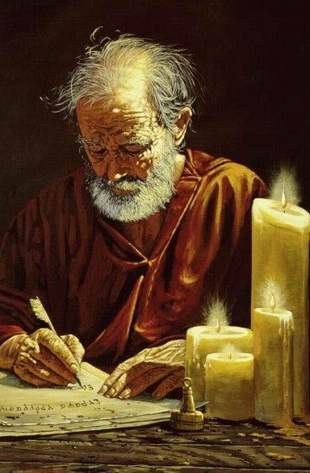
Hebrews
Central Message:
“For by one offering, He has perfected forever them that are sanctified . . . There is no more offering for sin.”
Hebrews 10:14, 18
Apostle Paul

Slide 64
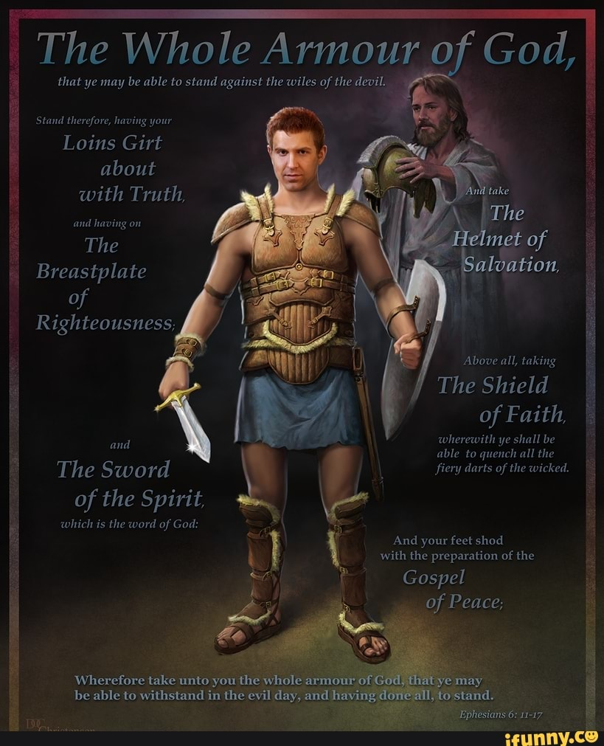

Slide 65


Slide 66
Summer Break
No Bible Study
until
7 September 2022

Slide 67
Lesson Applications
for a
Worthy Walk

Slide 68


Slide 69
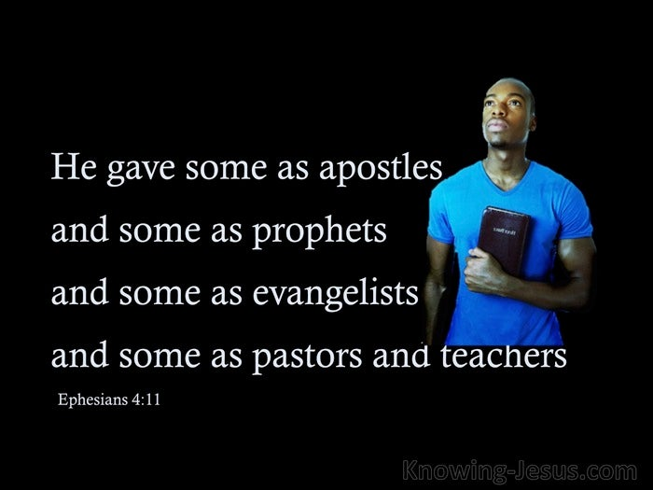

Slide 70
